Slide 1

WAY TO ENTERPRISE
AWS
VTI ACADEMY
Author: duy.nguyenngoc1@vti.com.vn

Slide 2
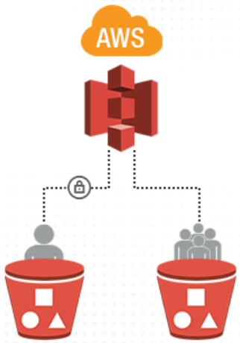
S3 Service
Stands for Simple Storage Service
Simply store files on the internet (ex: image, video, text, file log, ...)
Object-based storage (a file similar to a object)
Infinitely scaling, reliable, durable, secure, inexpensive
Many AWS services integration
Global Service
Usecases: store files, backup file, hosting website, ...
https://docs.aws.amazon.com/AmazonS3/latest/userguide/Welcome.html

Slide 3
S3 Service
Demo
Create Bucket
Upload Objects into bucket
Allow Public Access
Versioning
Create folder
Hosting static website

Slide 4
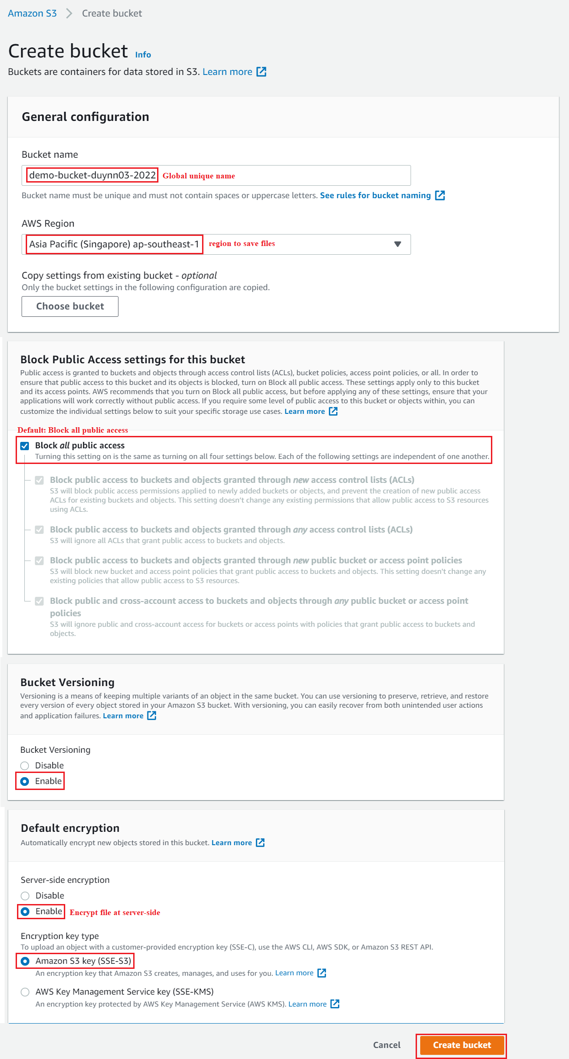
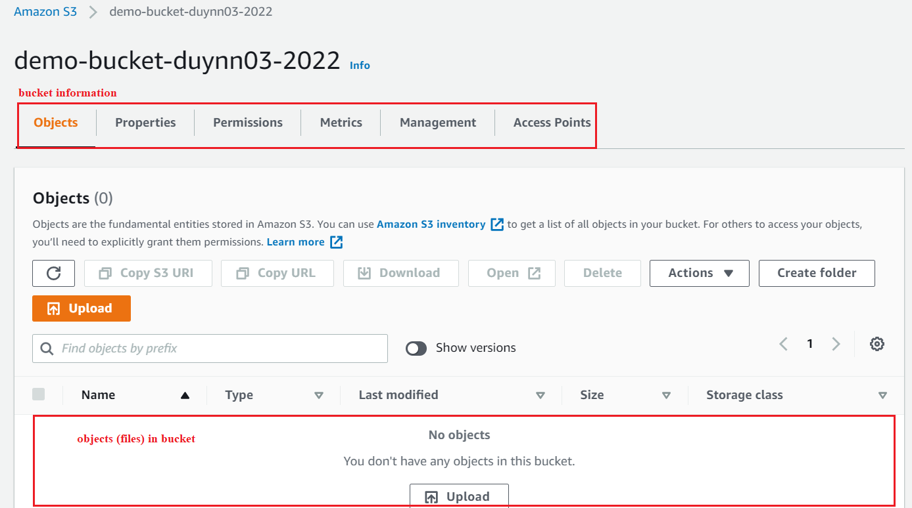
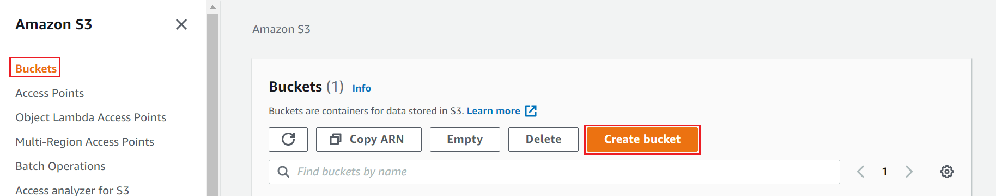
S3 Service
Create Bucket
Detail Information

Slide 5
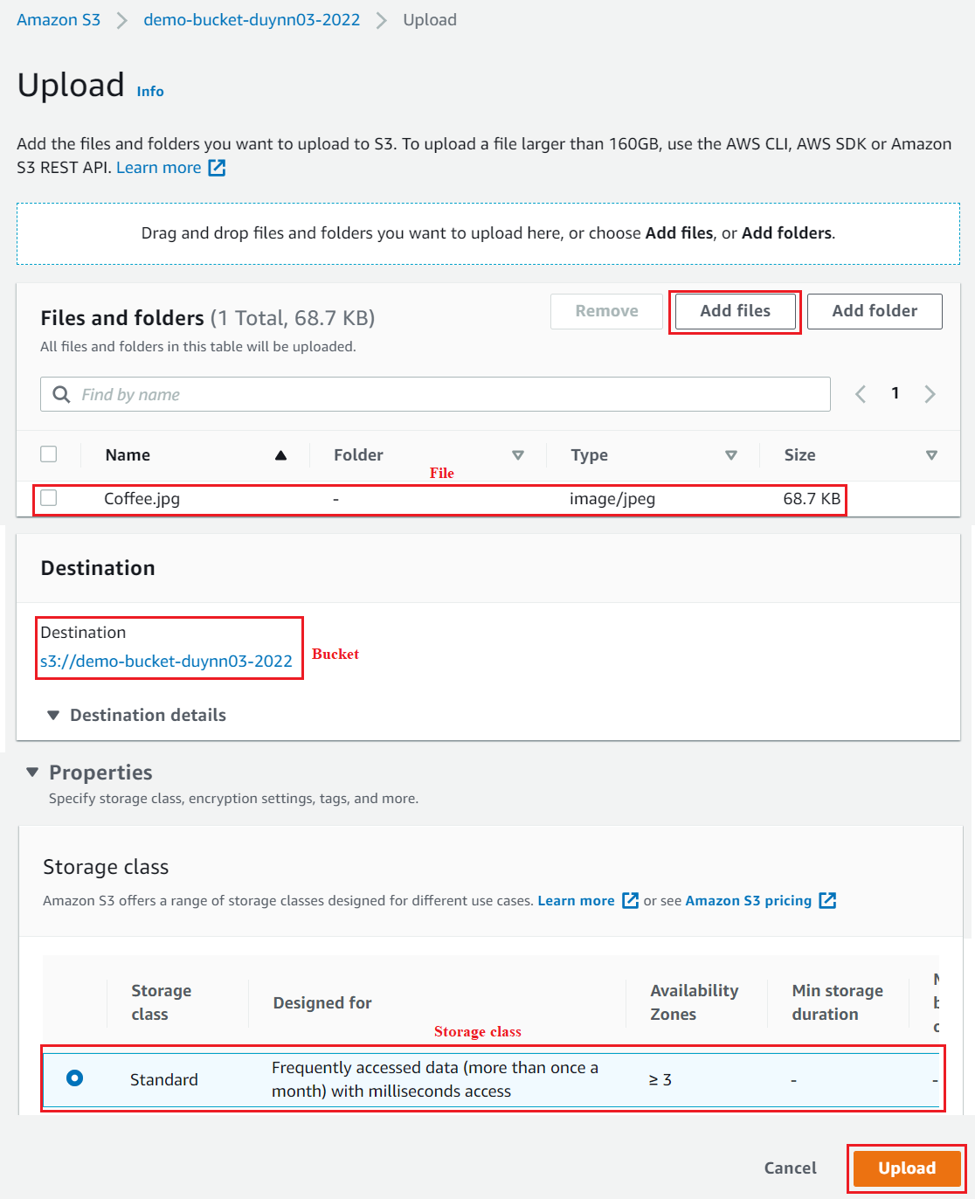
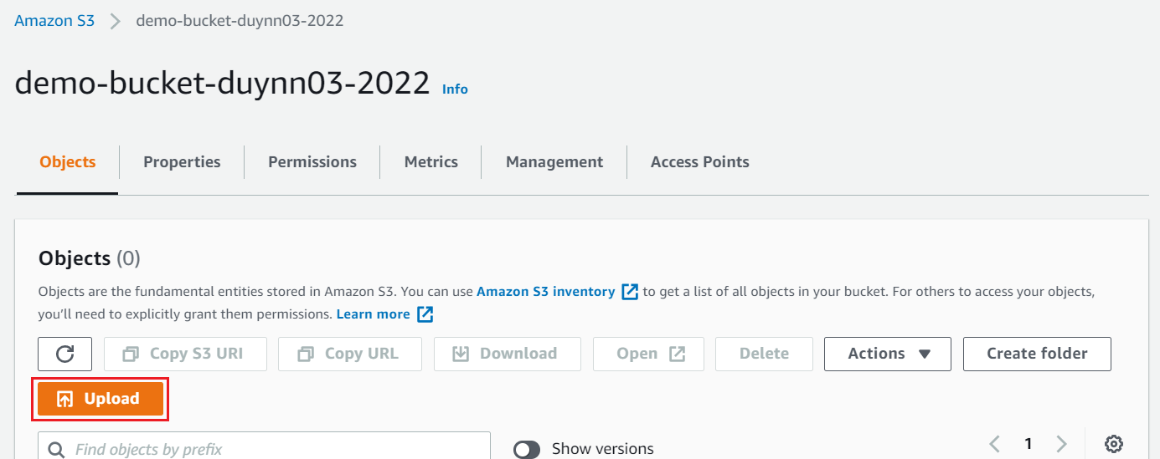
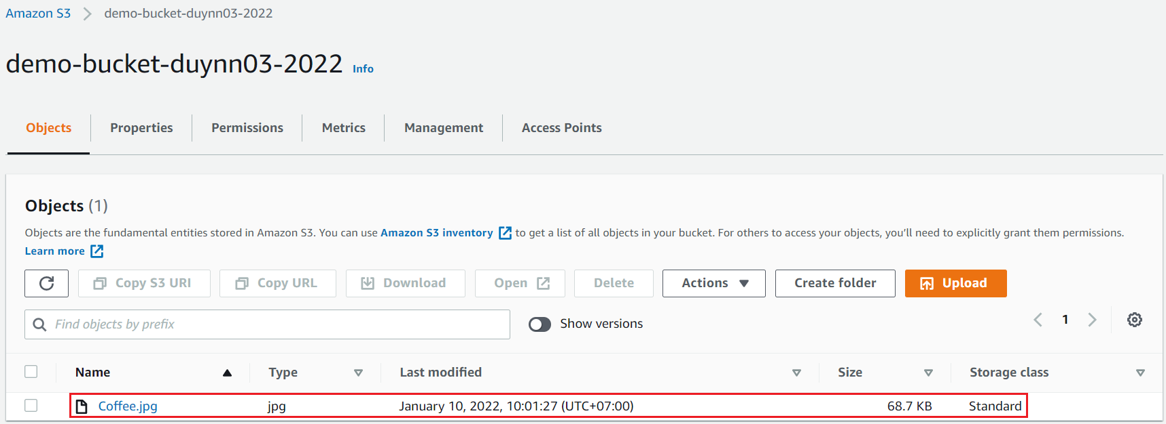
S3 Service
Upload Objects into bucket
Detail Information

Slide 6
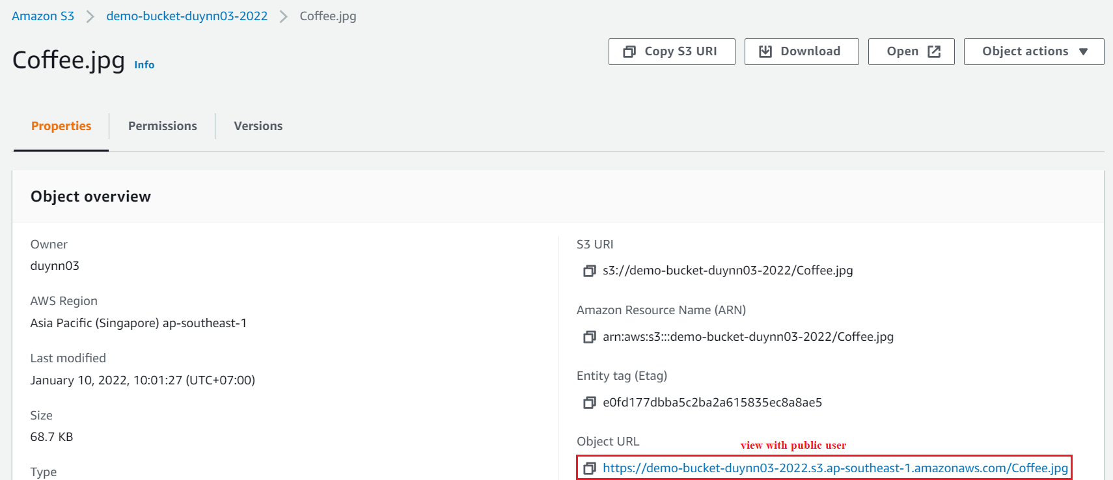
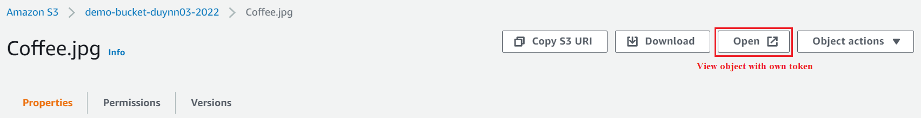
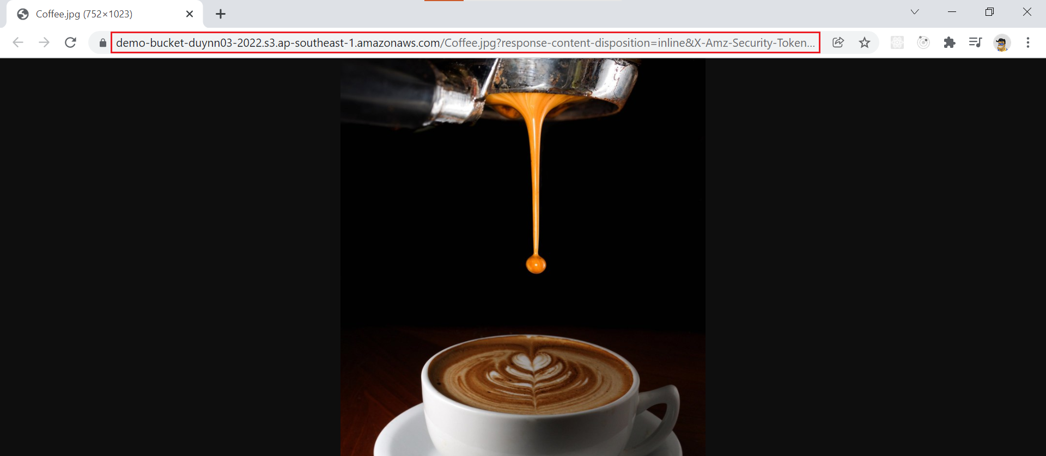
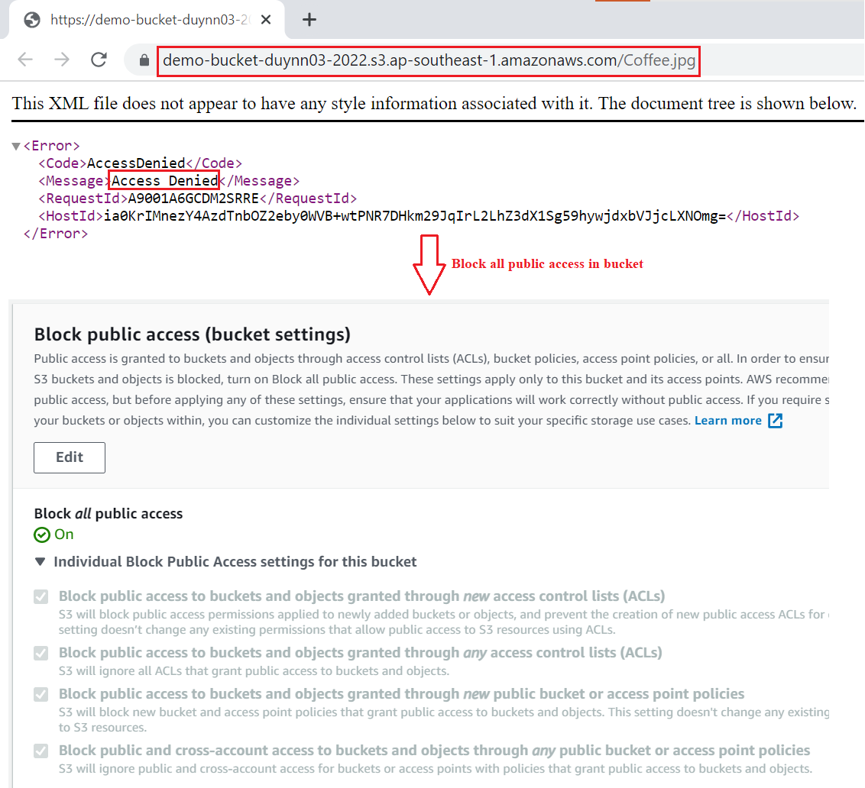
S3 Service
View Object with owner token
View Object with Public User

Slide 7
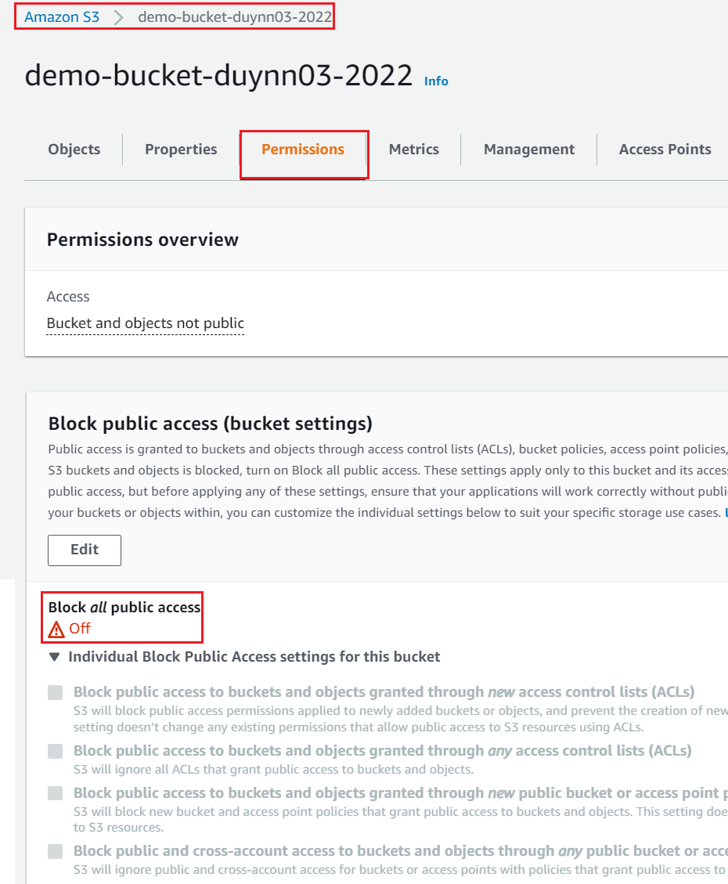
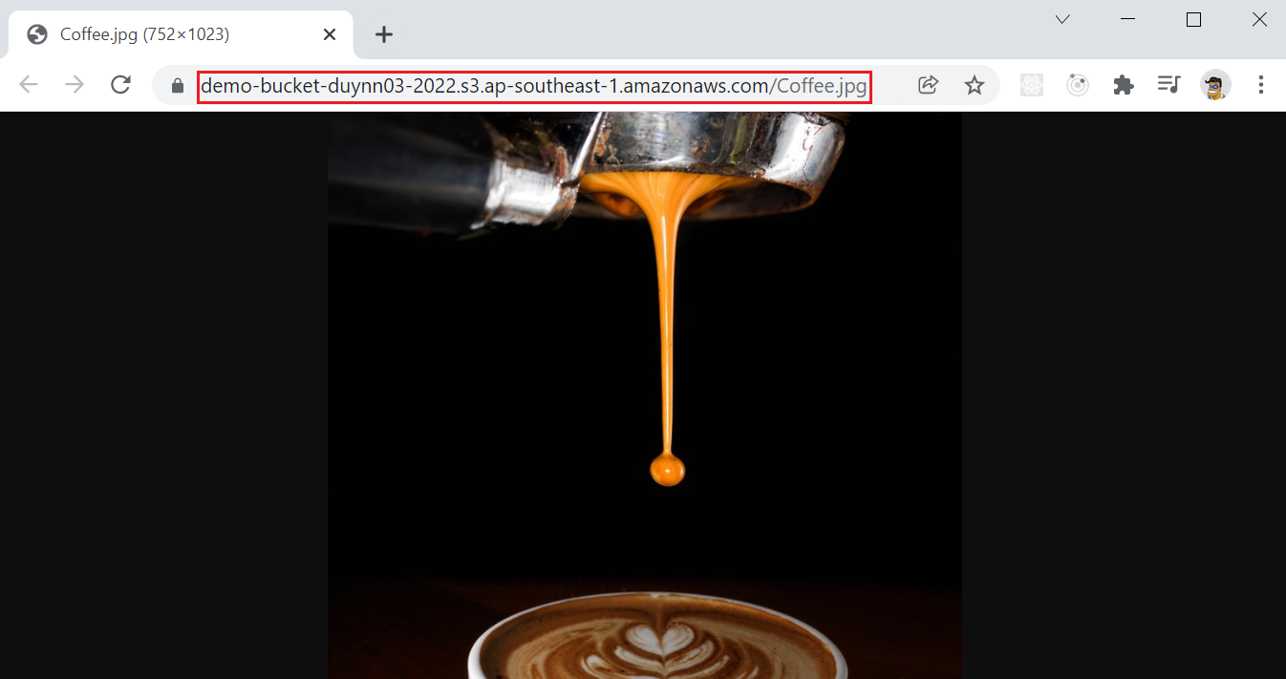
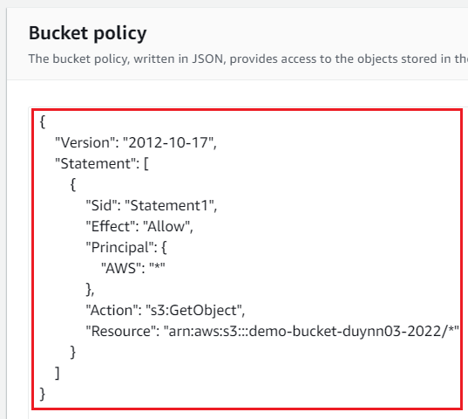
S3 Service
Allow Public Access

Slide 8
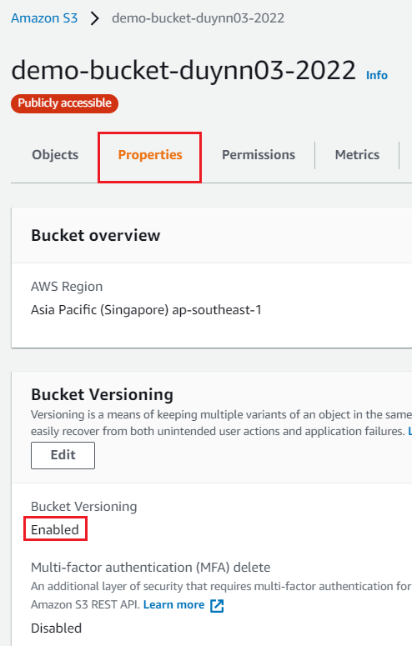
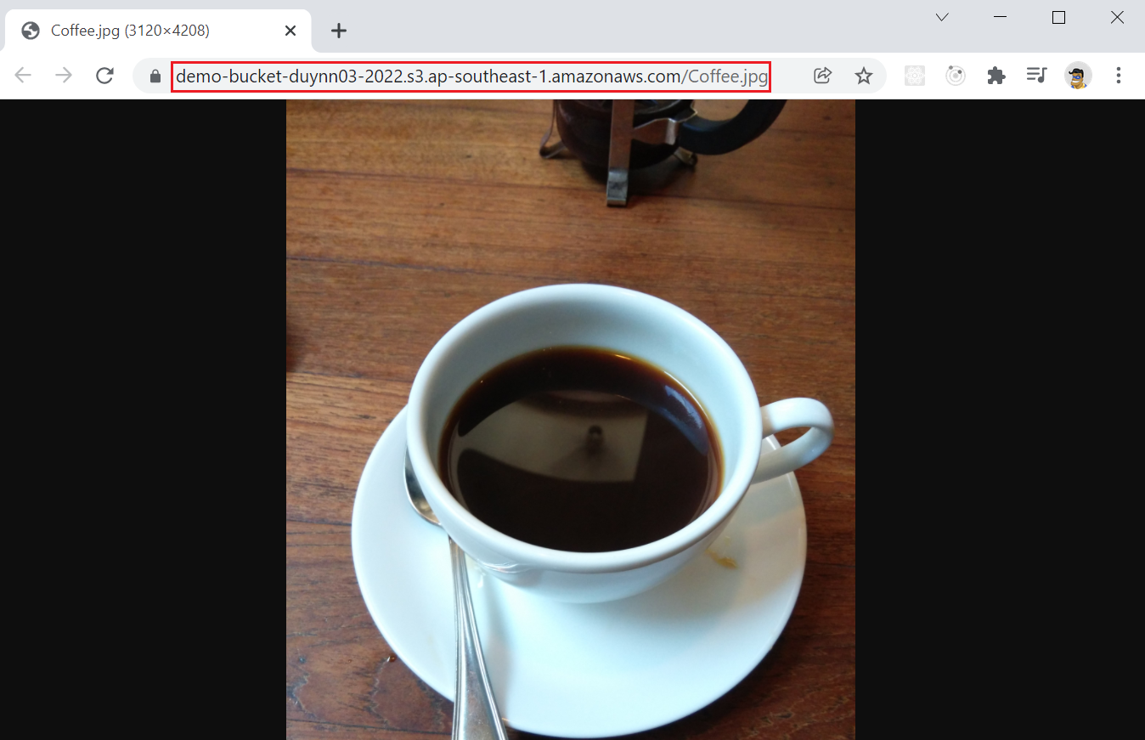
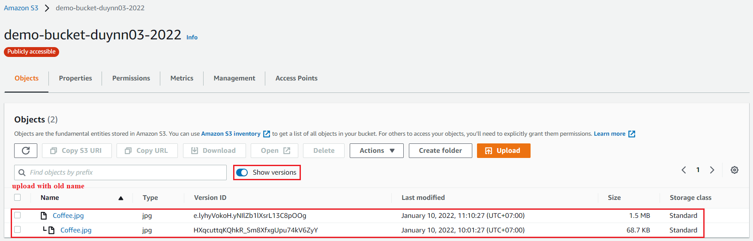
S3 Service
Versioning
Upload new version

Slide 9
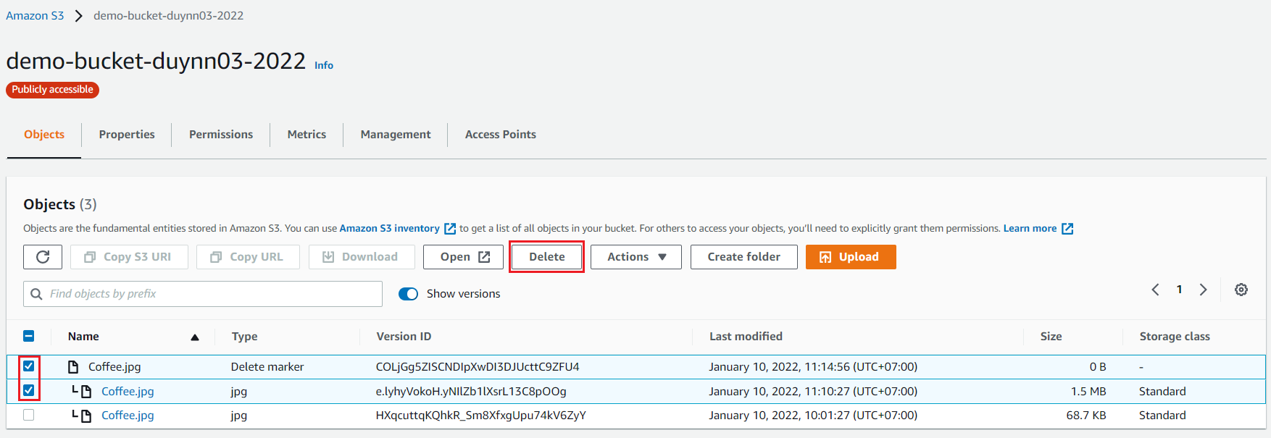
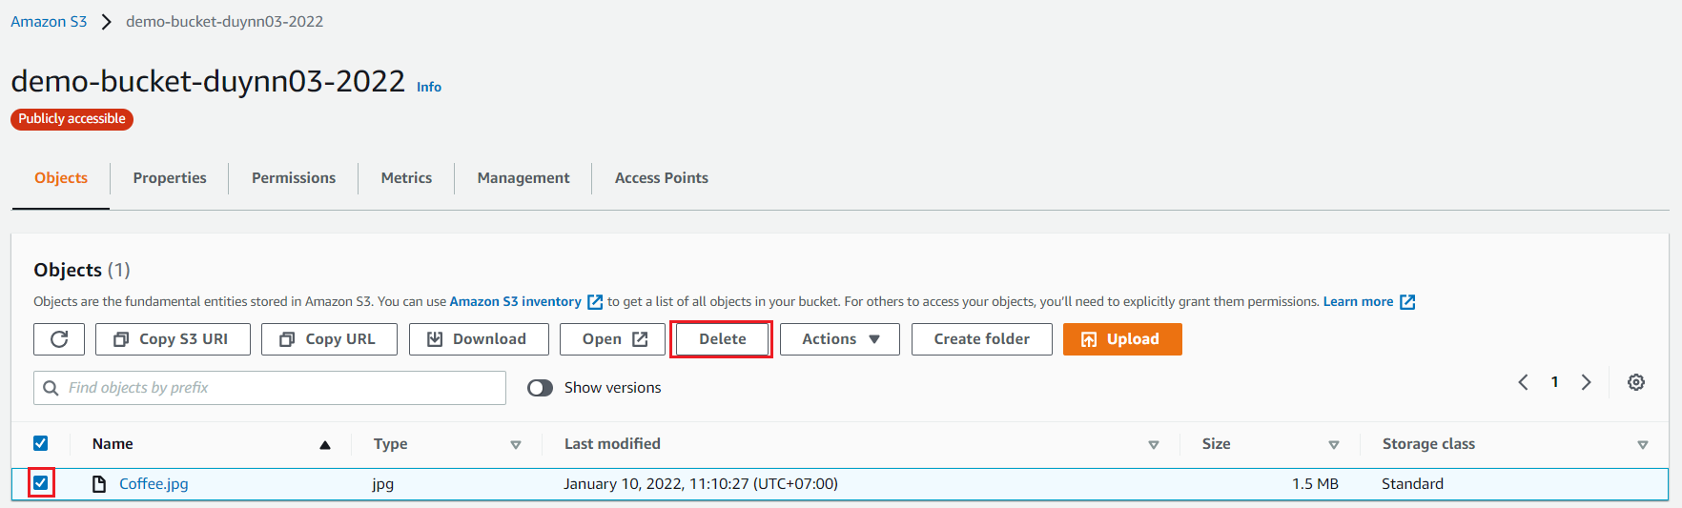
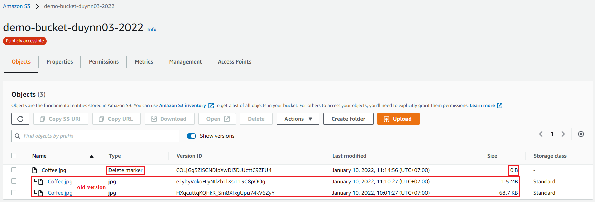
S3 Service
Delete object
Delete specific Object & Restore old version

Slide 10
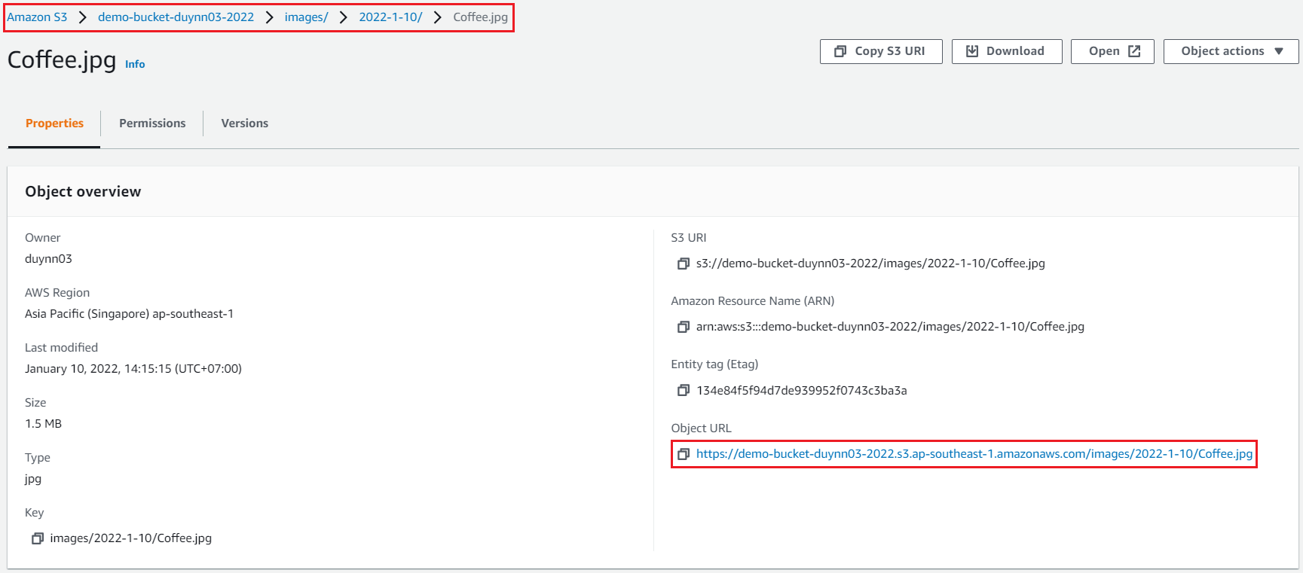
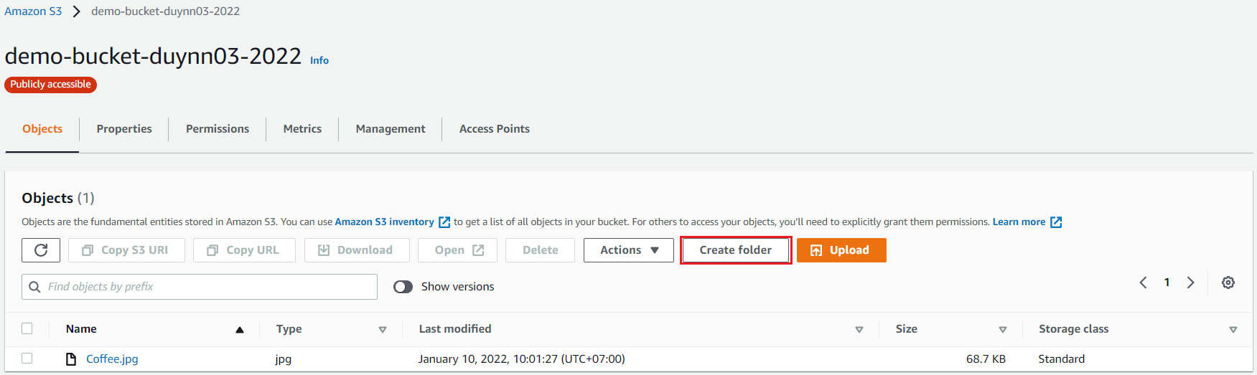
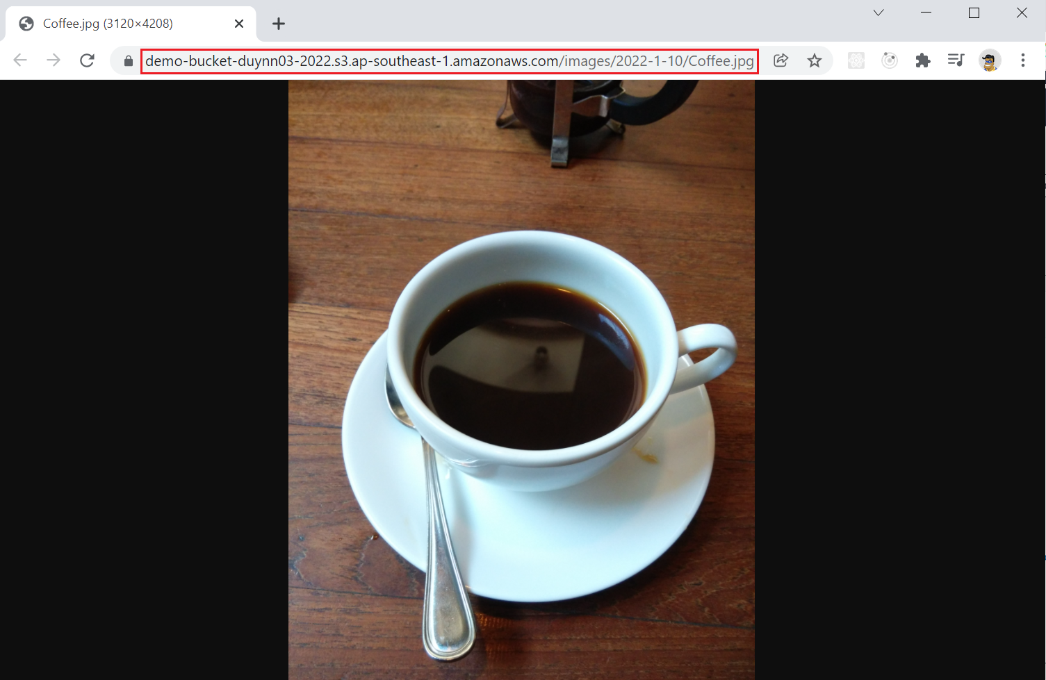
S3 Service
Create folder
Upload file
Create folder /images/2022-1-10

Slide 11
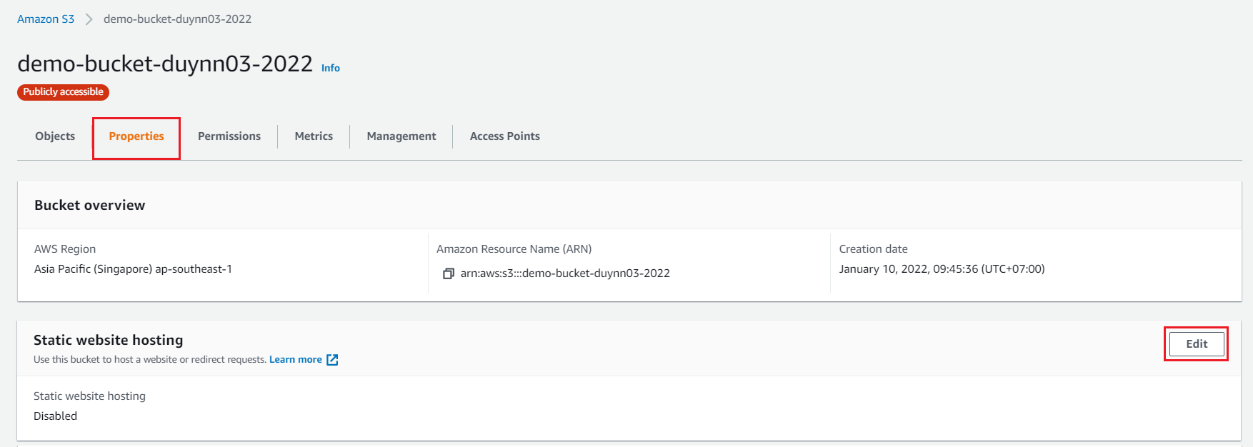
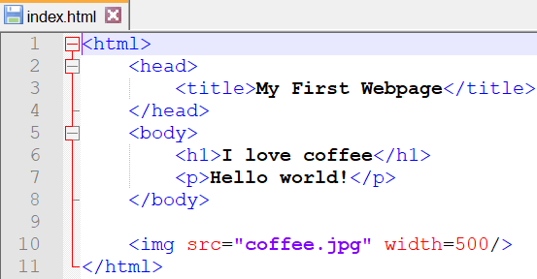
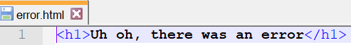
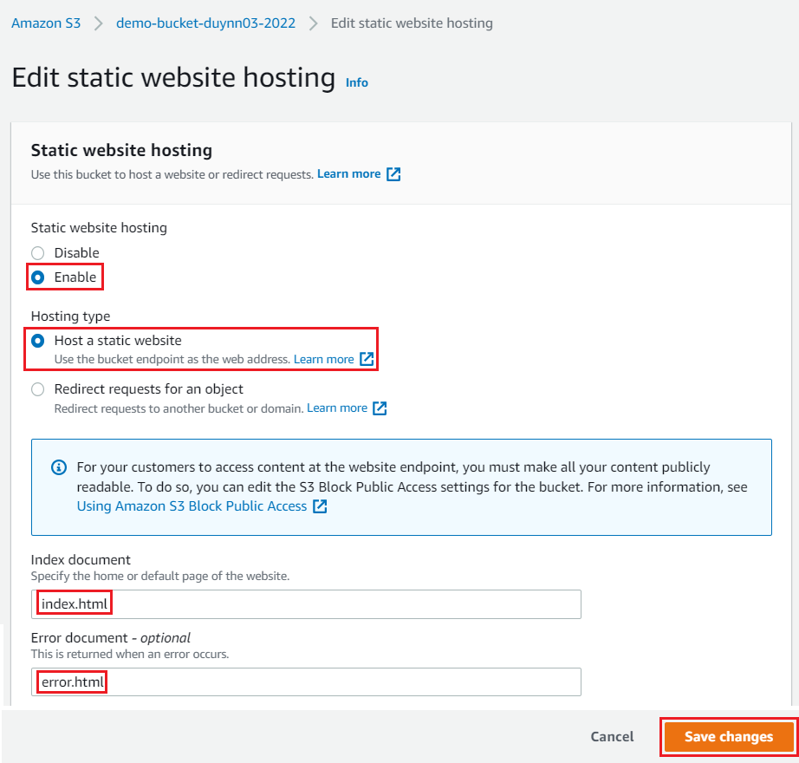
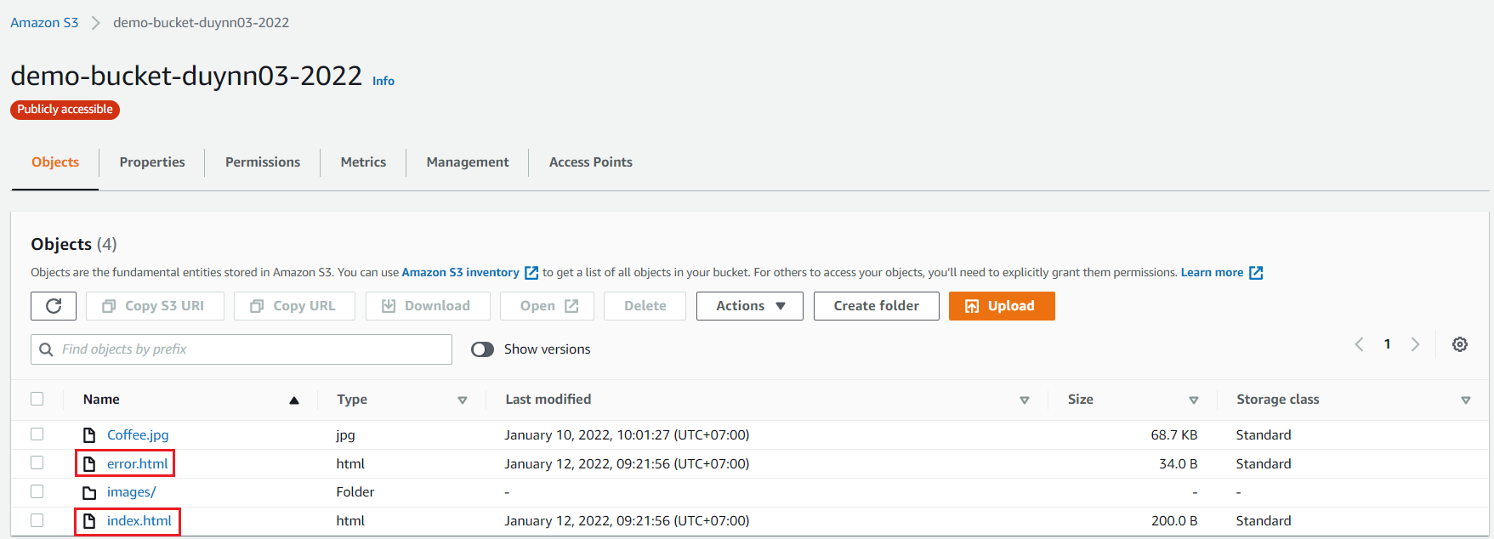
S3 Service
Hosting static website
Upload 2 file index.html & error.html
Config Hosting Website

Slide 12
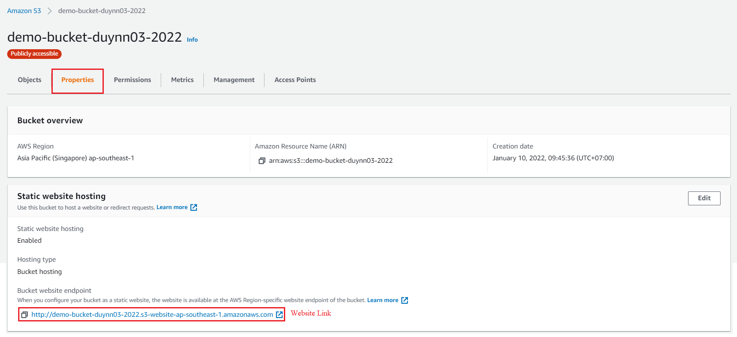
S3 Service
Website Link (Endpoint)
Config Bucket policy & Block public access

Slide 13
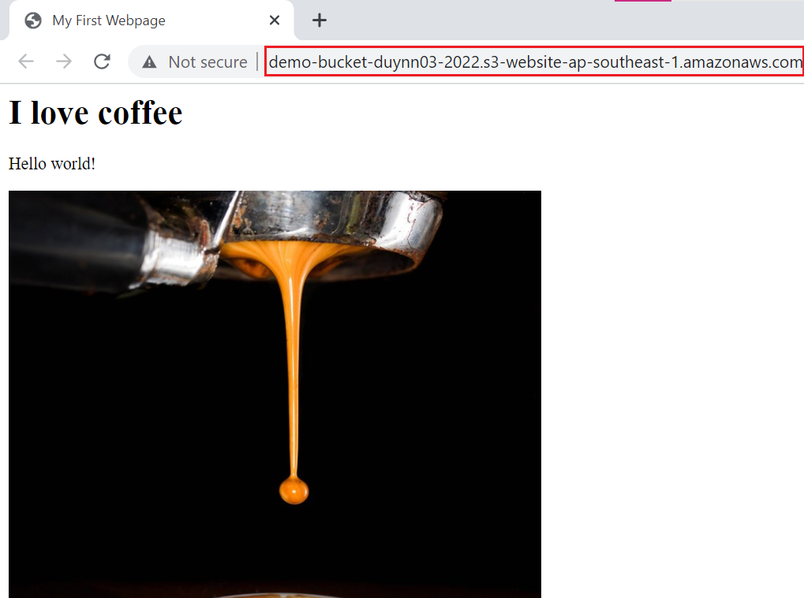
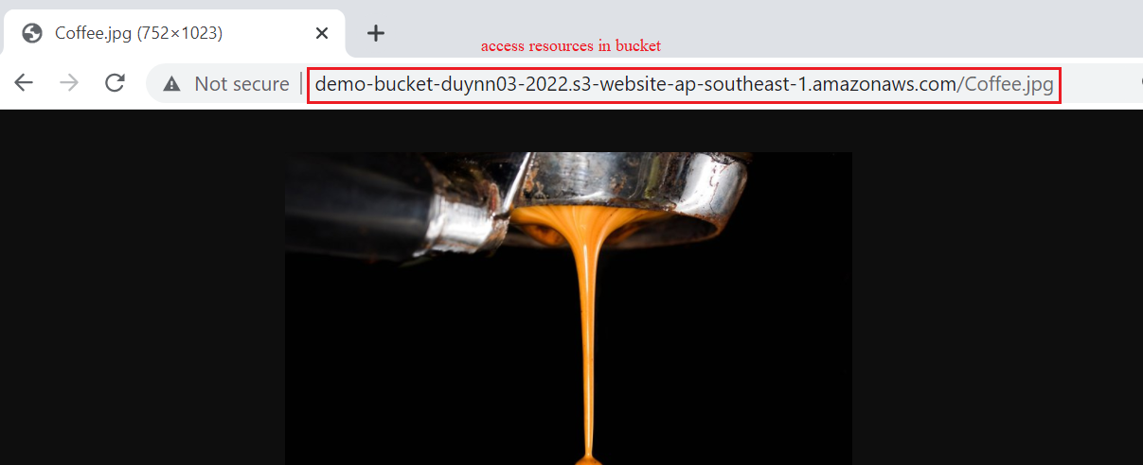
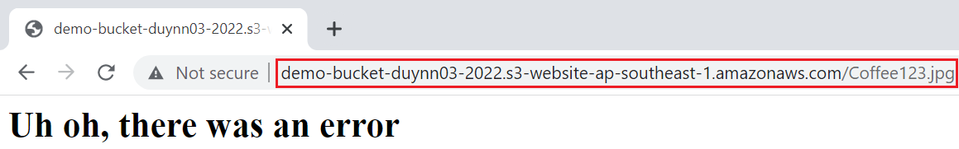
S3 Service
Accessing Website

Slide 14
Assignment
Self-practice

Slide 15
S3 Service
Components
Bucket
Object
Storage class
Price

Slide 16
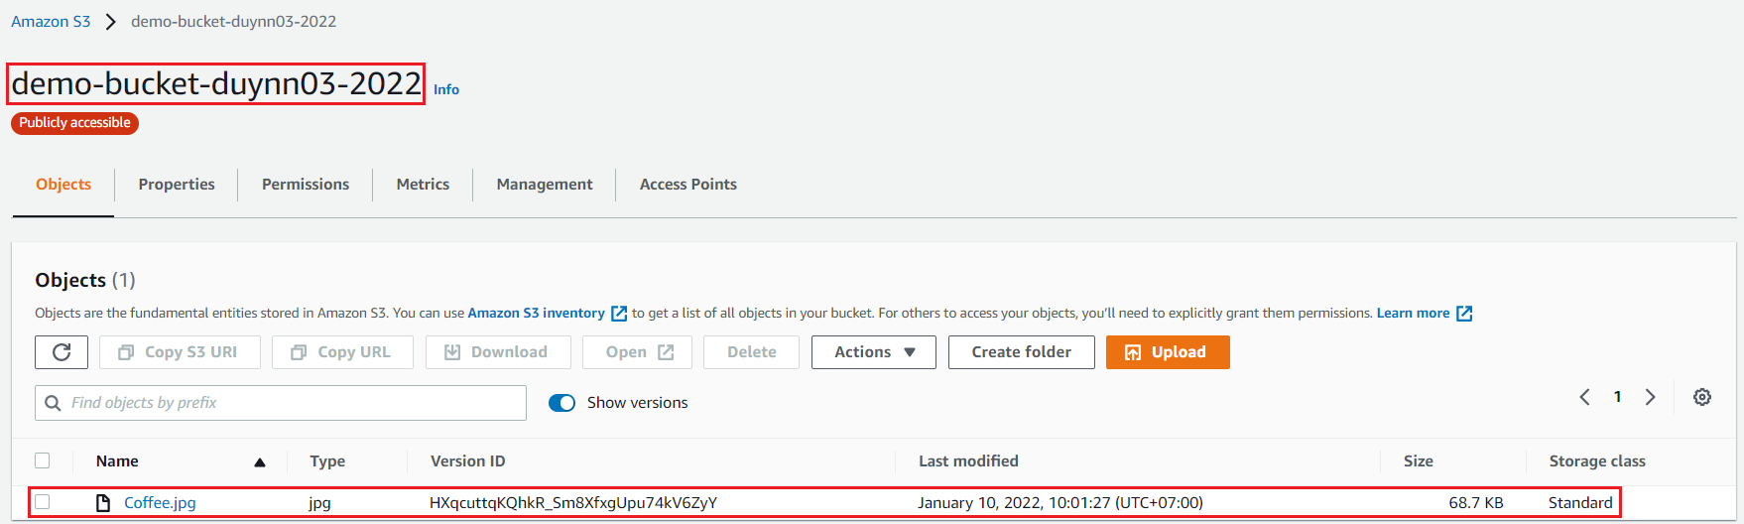
S3 Service
Bucket
Is a container, folder to store objects (files)
Globally unique name (similar to ID in region)
Naming Rules: Link
Cannot rename bucket
Not support nested bucket
Max 100 buckets per account
Region resource

Slide 17
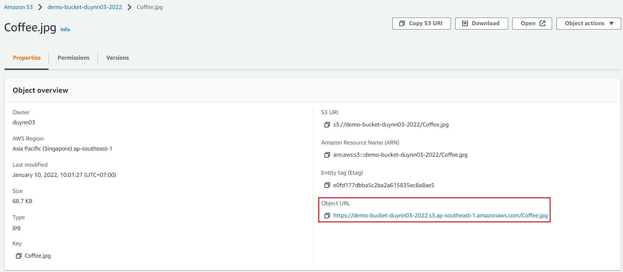
S3 Service
Object
Is a file
Size: 0 bytes 🡪 5 TB
Format: audio, image, text, file log, ...
Cannot limit file amount
Components: meta data & data

Slide 18
S3 Service
Key
Is Object ID
Unique Identity = BucketName + Key + Version (Key = prefix + objectName)
Ex: s3://my-bucket/my_folder/another_folder/my_file.txt
Object URL : bucketname.s3.[region].amazonaws.com/prefix/objectName
S3 is unstructured 🡺 using prefixes to specify objects (Similar to folder)

Slide 19
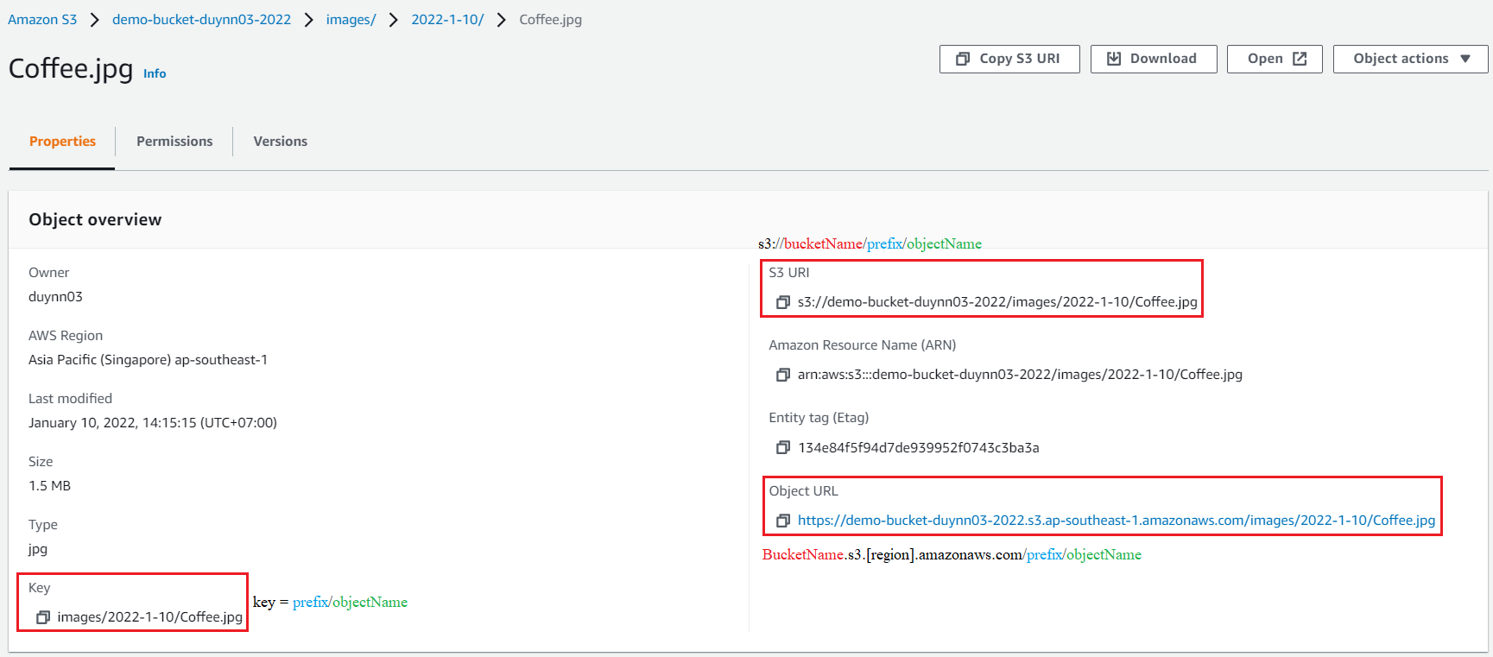
S3 Service

Slide 20
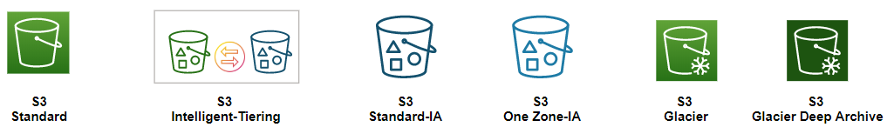
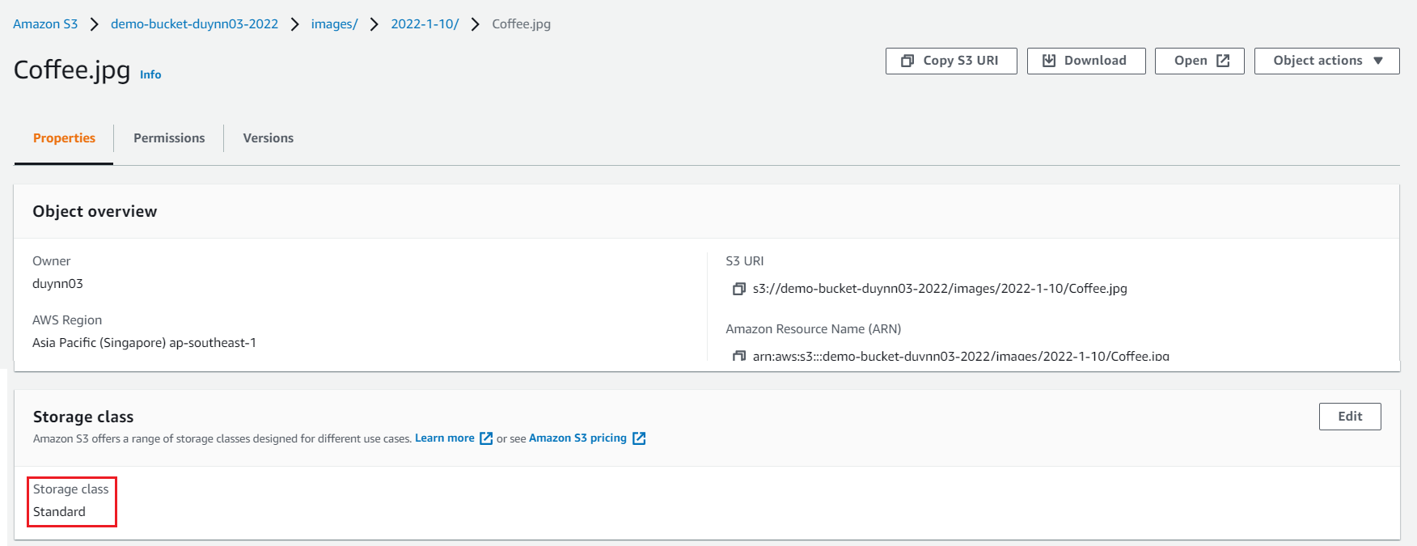
S3 Service
Storage classes
Standard
Standard-IA
One zone-IA
Intelligent tiering
Glacier
Glacier deep archive
Reduced Redundancy Storage (deprecated)
Storage Classes

Slide 21
S3 Service
Standard (Most used)
Highest cost
Store data in multiple zones
Usecases: General purpose, Big Data analytics, mobile & gaming applications, content distribution, …
One zone – IA
Cheaper than Standard
Store data in only a zone
Usecases: Infrequent access, storing secondary backup copies of on-premise data
Standard Infrequent Access (Standard-IA)
Cheap hosting but expensive access
Store data in multiple zones
Usecases: Infrequent access file, As a data store for disaster recovery, backups…

Slide 22
S3 Service
Glacier
Low cost
Not immediately accessible (take 3🡪5 hours, up to 12 hours
Data is retained for the longer term (10s of years)
3 retrieval options: Expedited (1 to 5 minutes), Standard (3 to 5 hours), Bulk (5 to 12 hours)
Minimum storage duration of 90 days
Usecases: backup files
Glacier deep archive
Lowest cost
Take up to 12 hours for accessing files
2 retrieval options: Standard (12 hours), Bulk (48 hours)
Minimum storage duration of 180 days
Usecases: files are only accessed a few times a year

Slide 23
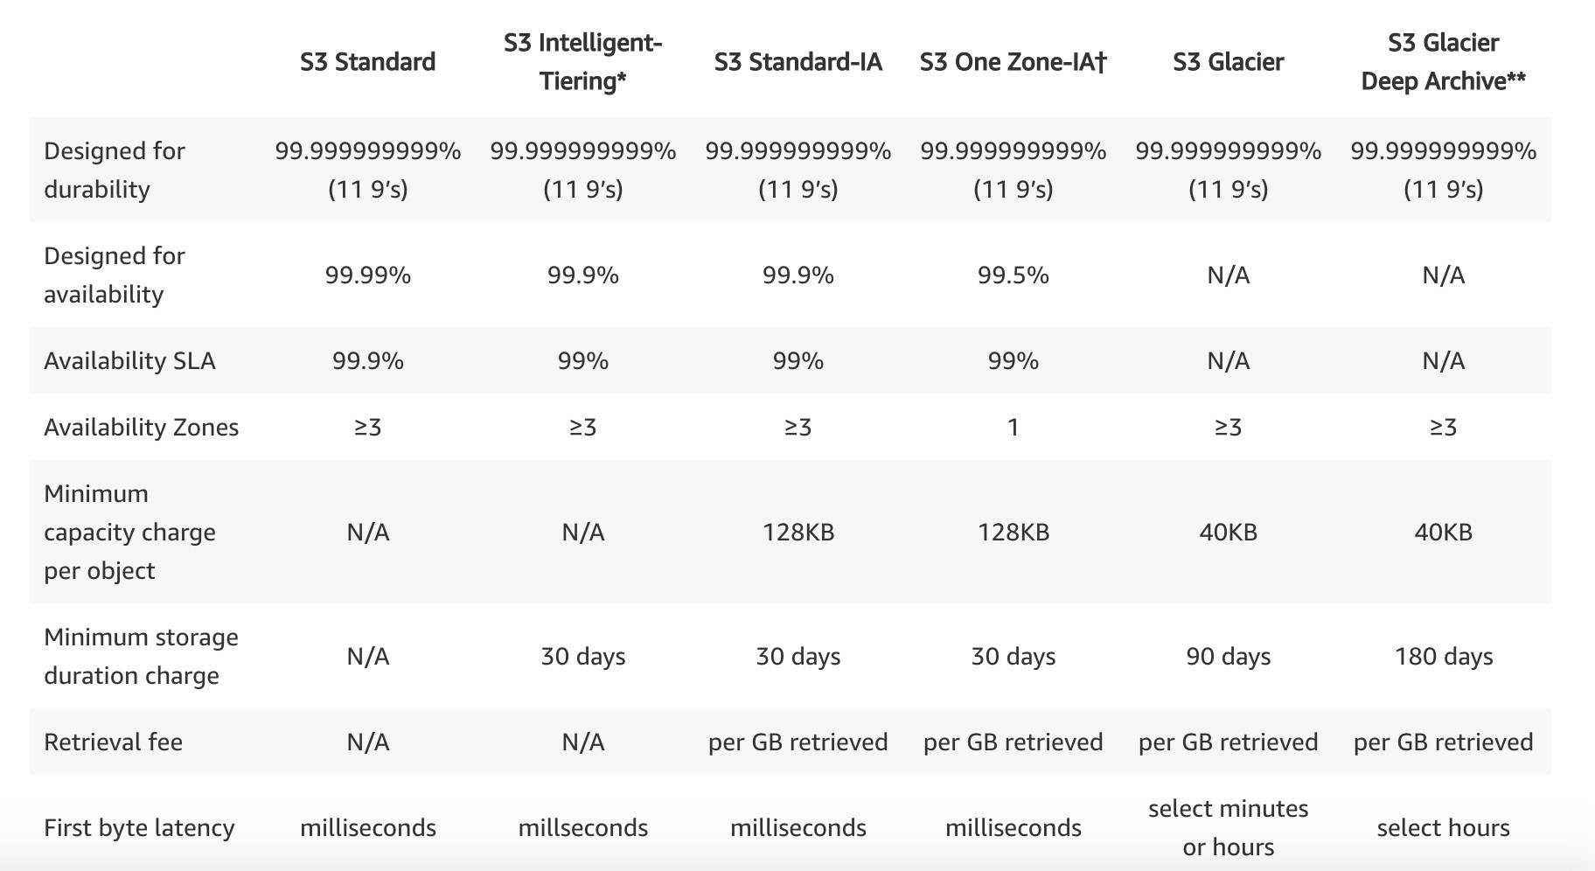
S3 Service
Intelligent tiering
Automatically moves objects between two access tiers based on changing access patterns
Rarely used
https://aws.amazon.com/s3/storage-classes

Slide 24
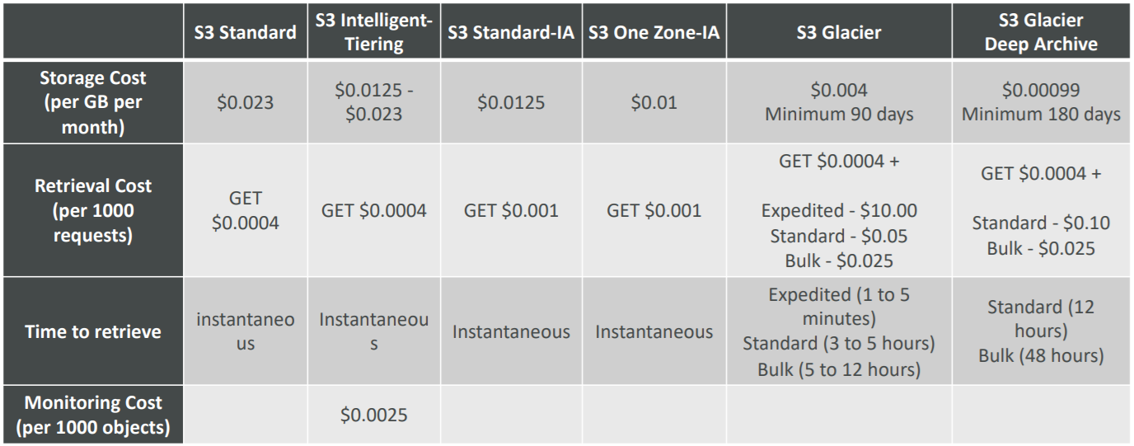
S3 Service
Example:
us-east-2

Slide 25
S3 Service
Best practices
Frequent Access 🡺 Choose Standard
After 1 to 3 months, the traffic decreases a lot 🡺 Choose IA
After 3 months, there is almost no access 🡺 Choose Glacier
After 6 months, there is almost no access 🡺 Choose Glacier Deep Archive
For objects you don’t need in real-time 🡺 Choose Glacier

Slide 26
S3 Service
Price
Storage
Request, delete,... manipulate data
Transfer data in – free (Uploading is free)
Transfer data out – charge (Downloading file will charged fee)
Transfer acceleration
Storage management (fee managed by aws)
Replication
Cross region

Slide 27
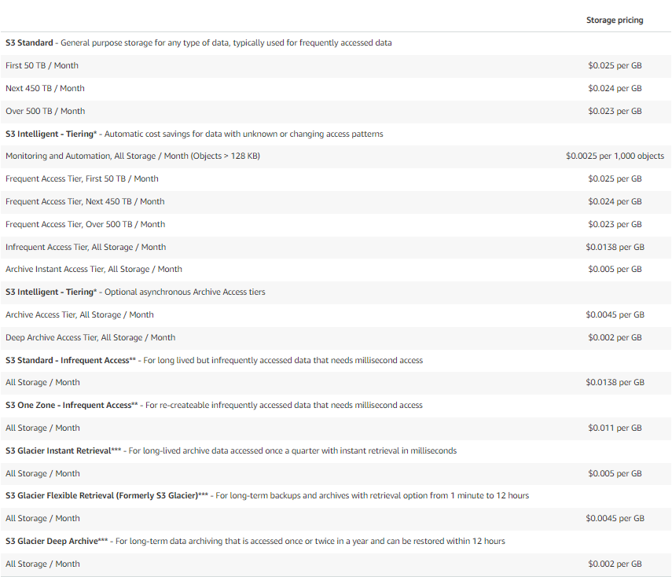
S3 Service
Price: https://aws.amazon.com/s3/pricing
Estimate cost: https://calculator.aws/#/createCalculator/S3

Slide 28
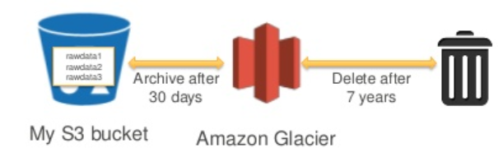
S3 Service
S3 Glacier
Low cost object storage meant for archiving / backup
Data is retained for the longer term (10s of years)
Lifecycle policy
Every month, you can take out 5% of the free storage, get more will be charged
Deleting data before 90 days will also be charged
Lifecycle policy

Slide 29
S3 Service
Components:
Vaults
Archives

Slide 30
S3 Service
Vaults
Is a container, folder to store Archives (files)
Max 1000 vaults per region
Archives
Store object (image, text, file, ...)
Max 40 TB
No limit archives amount
Tutorial: https://www.youtube.com/watch?v=_ejkzECBLhI
https://docs.aws.amazon.com/amazonglacier/latest/dev/amazon-glacier-getting-started.html

Slide 31
Assignment
Self-practice

Slide 32
S3 Service
Features
Versioning
Encryption
Security
S3 Access Logs
Replication
Pre-Signed URLs
Lifecycle Management
Multipart uploads & Byte-range fetches
S3 Transfer Acceleration
Delete Object
Data consistency
Prefix
Object Lock
Requester Pays
Notification
S3 Select
Hosting static website
CORS
Accessing S3 from EC2

Slide 33
S3 Service
Versioning
Allow uploading multiple versions of file, protect against unintended deletes
Enabled at the bucket level
Cannot disable
Price: charged 2 files

Slide 34
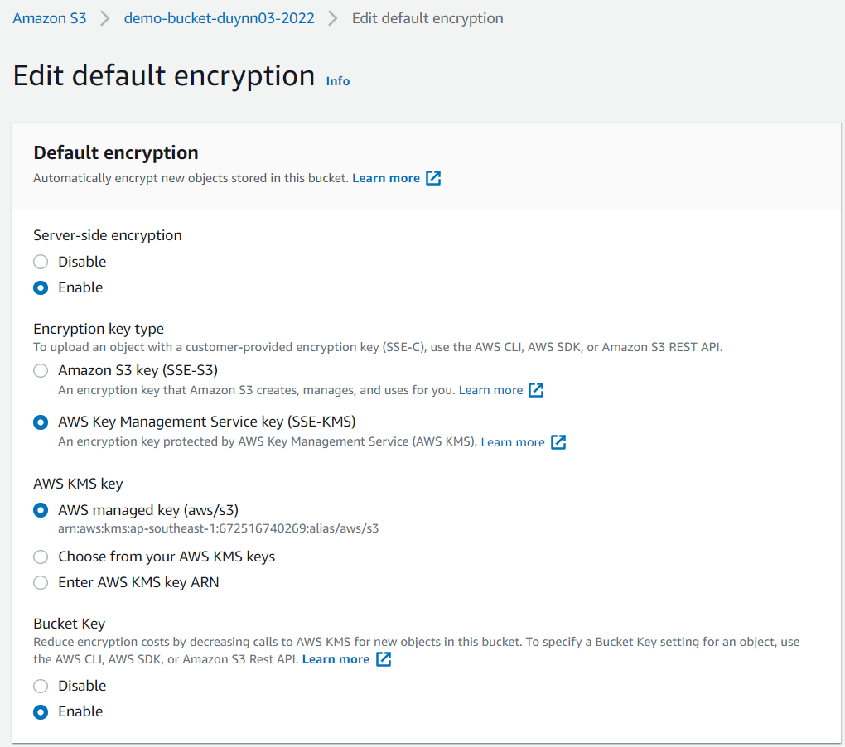
S3 Service
Encryption
Server side Encryption (SSE, At-rest)
SSE-S3: encrypts objects using keys handled & managed by AWS
SSE-KMS: Using Key Management Service to manage encryption keys
SSE-C: when you want to manage your own encryption keys
Client Side Encryption (In transit)

Slide 35
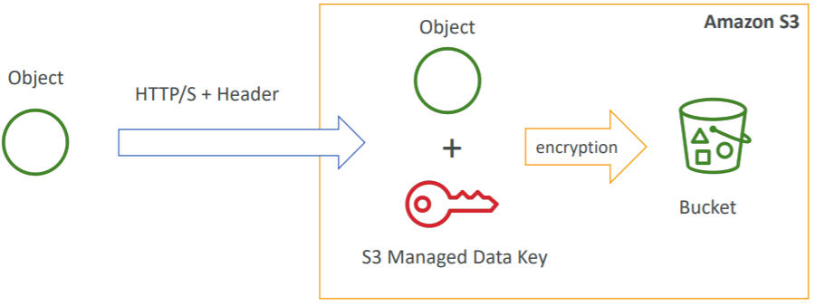
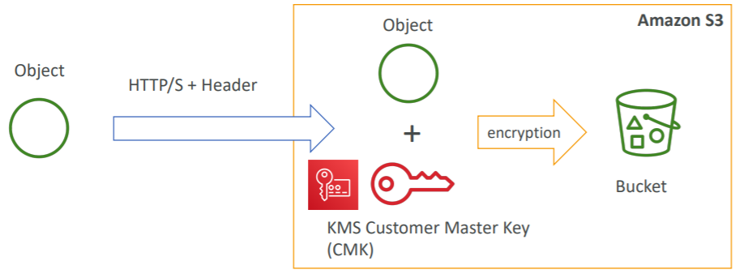
S3 Service
SSE-S3
SSE-KMS
header: “x-amz-server-side-encryption": "AES256"
header: “x-amz-server-side-encryption": ”aws:kms"

Slide 36
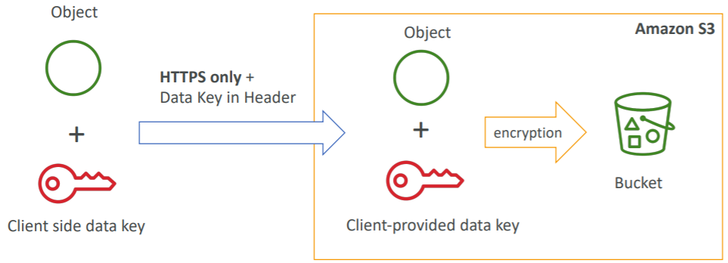
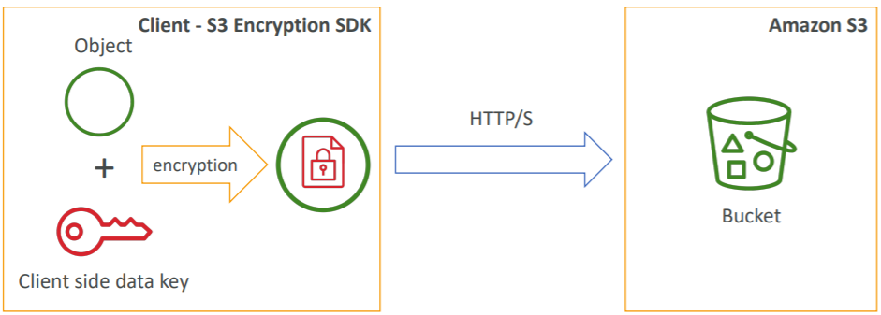
S3 Service
SSE-C
Client Side Encryption
Every request provided headers
S3 does not store the encryption key
Clients must encrypt data before sending to S3
Clients must decrypt data when retrieving from S3

Slide 37
S3 Service
In transit (SSL/TLS)
Amazon S3 supports both HTTP & HTTPS
HTTPS is recommended

Slide 38
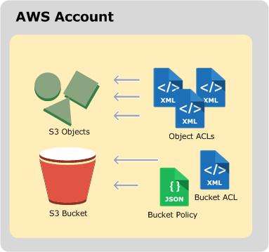
S3 Service
Security
User based
IAM policies
Resource Based
Bucket Policies
Bucket Access Control List (ACL)
Object Access Control List (ACL)

Slide 39
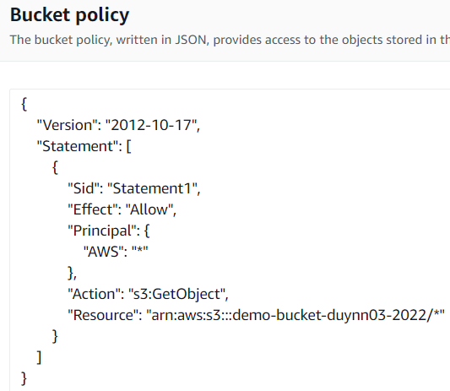
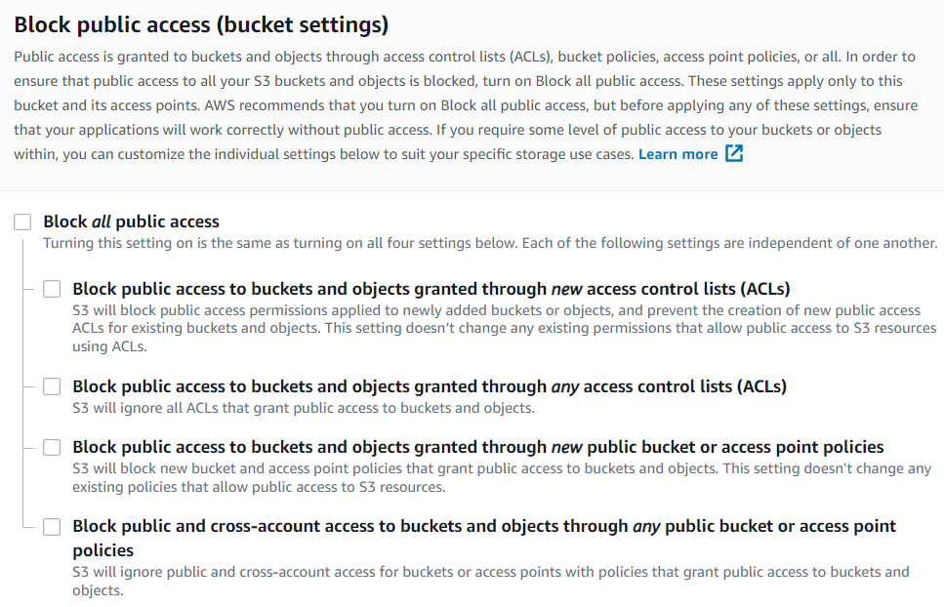
S3 Service
Bucket Policies
Grant public access to the bucket
Force objects to be encrypted at upload
Grant access to another account (Cross Account)
Block public access use for preventing company data leaks
Bucket policy
Block public access

Slide 40
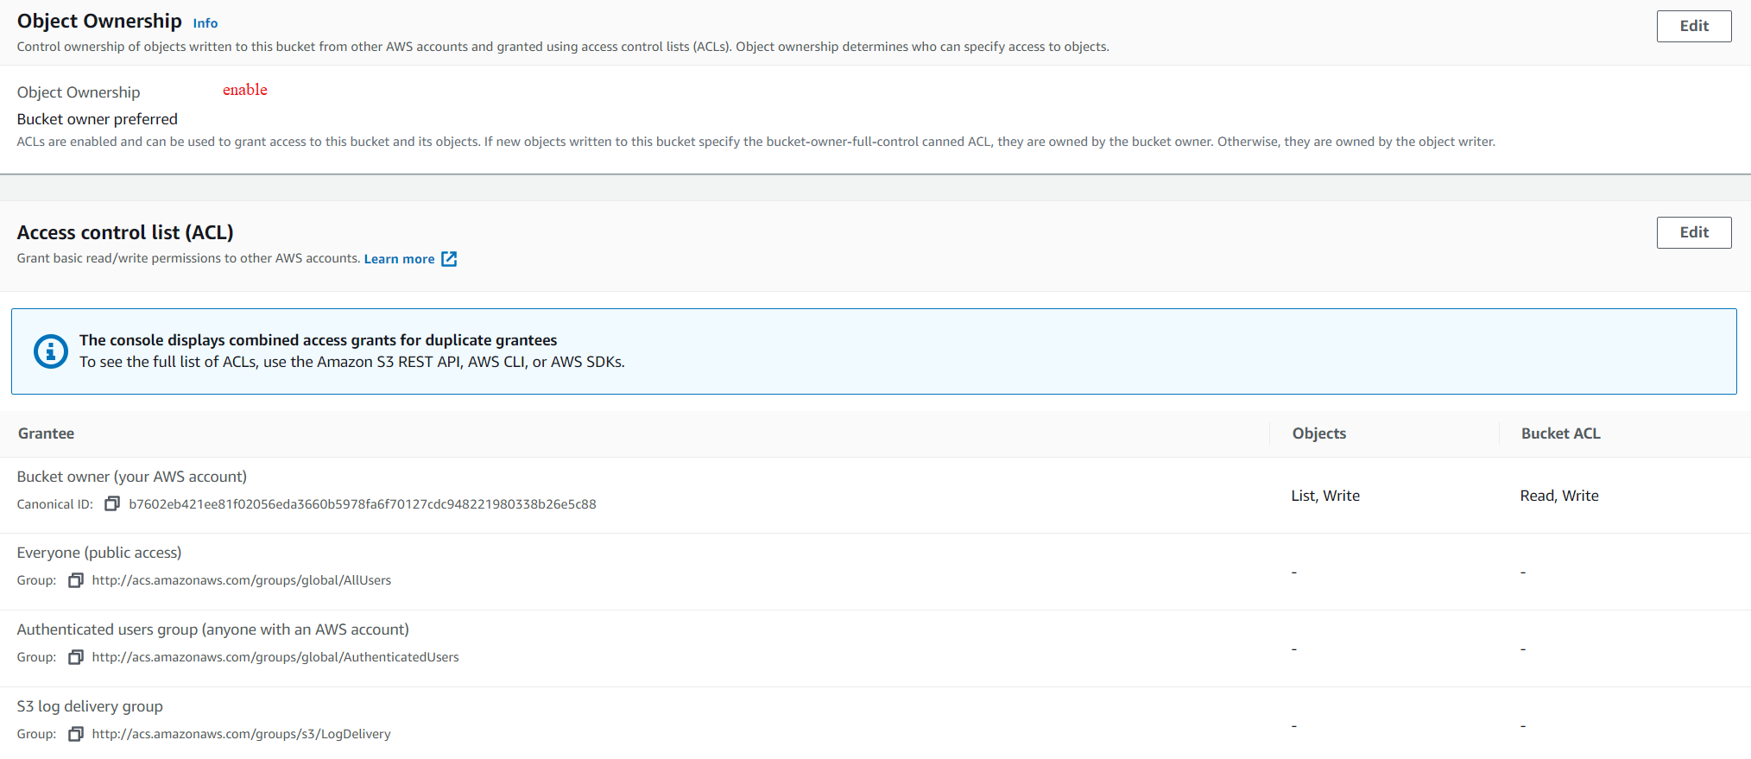
S3 Service
Bucket Access Control List (ACL) & Object Access Control List
Grant basic read/write permissions to other AWS accounts

Slide 41

S3 Service
S3 Access Logs
For audit purpose, you may want to log all access to S3 buckets
That data can be analyzed using data analysis tools…
Format: https://docs.aws.amazon.com/AmazonS3/latest/userguide/LogFormat.html
Tutorial: https://www.youtube.com/watch?v=NPHyJpd1Gxg

Slide 42

S3 Service
Replication
2 types:
Cross Region Replication (CRR)
Compliance, lower latency access, replication across accounts
Same Region Replication (SRR)
Log aggregation, live replication between production and test accounts
Must enable versioning in source and destination
After activating, only new objects are replicated (not retroactive)
Tutorial: https://www.youtube.com/watch?v=zDXXW8Qs5Gk

Slide 43

S3 Service
Pre-Signed URLs
Support SDK & CLI
Generate public URL to access Object in a certain period of time
Usecases:
Allow only logged-in users to download a premium video on your S3 bucket
Allow an ever changing list of users to download files by generating URLs dynamically
Allow temporarily a user to upload a file to a precise location in our bucket
Tutorial: https://blog.ascendingdc.com/quick-tutorial-to-integrate-amazon-s3-presigned-url/

Slide 44

S3 Service
Lifecycle Management
You can transit objects between storage classes
Transition actions: It defines when objects are transitioned to another storage class
Move objects to Standard IA class 60 days after creation
Move to Glacier for archiving after 6 months

Slide 45

S3 Service
Expiration actions: configure objects to expire (delete) after some time
Access log files can be set to delete after a 365 days
Can be used to delete old versions of files (if versioning is enabled)
Can be used to delete incomplete multi-part uploads
Tutorial: https://www.youtube.com/watch?v=CPUjRhrsMiI

Slide 46


S3 Service
Scenario 1
Scenario 2

Slide 47


S3 Service
Multipart uploads & Byte-range fetches
AWS SDK (for Application), REST API (for application not support SDK), AWS CLI allow upload single object up to 5 GB and can download multiple files at once
AWS Console allow upload single object up to 160 GB and can download 1 single file at once
If uploading more than 5GB, must use “multi-part upload” (Min: 5 MB, Max: 5 TB)
Byte-range fetches use for download

Slide 48

S3 Service
Best practices
If the file is larger than 100MB then use multipart file, byte-range fetches (1 part = 100 MB)
Must use for files > 5GB
https://docs.aws.amazon.com/AmazonS3/latest/userguide/upload-objects.html

Slide 49


S3 Service
S3 Transfer Acceleration (S3TA)
Increase transfer speed by transfering file to an AWS edge location which will forward the data to the S3 bucket in the target region
Support upload, download data when far away via Edge Loccation
Compatible with multi-part upload

Slide 50
S3 Service
Delete Object
API allow delete object up to 1000 objects at once
Only delete newest version 🡺 can restore object
Delete specific Object & Restore old version

Slide 51


S3 Service
Setup MFA to delete Object (Not support Console)
Tutorial: https://www.youtube.com/watch?v=EwNHu3BUW1w
Set up Lifecycle Management for automatically removing object

Slide 52
S3 Service
Data consistency
Strong read-after-write consistency
After a successful write of a new object (new PUT) or an overwrite or delete of an existing object (overwrite PUT or DELETE) then User subsequent read request immediately receives the latest version of the object

Slide 53
S3 Service
Prefix
S3 automatically scales to high request rates, latency 100-200 ms
Your application can achieve at least 3,500 PUT/COPY/POST/DELETE and 5,500 GET/HEAD requests per second per prefix in a bucket
There are no limits to the number of prefixes in a bucket, no additional cost

Slide 54
S3 Service
Example:
Prefix: /data/ 🡺 3500/s for UPDATE & 5,500/s for GET
Prefix: /data/2021/08/14/ and /data/2021/08/15/ 🡺 7000/s for UPDATE & 11000/s for GET
Best practices
Create prefix as much as possible
Random prefix

Slide 55


S3 Service
Object Lock
Can't delete or edit uploaded files
Use for "Write Once Read Many" (WORM) files
Default: Disable, Auto enable Versioning
2 retention
Retention Period: specifies a fixed period
Legal Hold: same protection, no expiry date
Tutorial: https://www.youtube.com/watch?v=BSTqsN2Jms8

Slide 56
S3 Service
2 mode: Governance, Compliance
Governance mode: users can't overwrite or delete an object version or alter its lock settings unless they have special permissions
Compliance mode: a protected object version can't be overwritten or deleted by any user, including the root user in your AWS account

Slide 57

S3 Service
Requester Pays
In general, bucket owners pay for all Amazon S3 storage and data transfer costs associated with their bucket
With Requester Pays buckets, the requester instead of the bucket owner pays the cost of the request and the data download from the bucket
Helpful when you want to share large datasets with other accounts
Tutorial: https://www.youtube.com/watch?v=RS0yOxqM8cM

Slide 58

S3 Service
Notification
Getting notification when upload, delete, … objects
Tutorial: https://www.youtube.com/watch?v=EGyuzMbXD0Y

Slide 59


S3 Service
S3 Select
Works on objects stored in CSV, JSON, Apache Parquet format
Also works with objects that are compressed with GZIP or BZIP2, server-side encrypted objects
Using SQL Statement
The maximum length of a record in the input or result is 1 MB
Tutorial: https://www.youtube.com/watch?v=yqJwN8EBCw8
https://docs.aws.amazon.com/AmazonS3/latest/userguide/s3-glacier-select-sql-reference-select.html

Slide 60
S3 Service
Hosting static website
S3 can host static websites and have them accessible on the internet
Auto scaling
Name bucket is same of website domain
The website URL will be: <bucket-name>.s3-website-<AWS-region>.amazonaws.com

Slide 61
S3 Service
Upload 2 file index.html & error.html
Accessing Website
Tutorial: https://www.sqlshack.com/launch-a-static-website-using-aws-s3-buckets

Slide 62

S3 Service
CORS
CORS stands for Cross-Origin Resource Sharing
An origin is a scheme (protocol), host (domain) and port
Example
Same origin: http://example.com/app1 & http://example.com/app2
Different origins: http://www.example.com & http://other.example.com

Slide 63
S3 Service
Demo
Create resources bucket & config hosting website
Call resources bucket via Programming
Config CORS

Slide 64




S3 Service
Create resources bucket & config hosting website
Config Bucket policy & Block public access
Create other bucket & upload resources

Slide 65




S3 Service
Access resources in bucket
Config hosting website

Slide 66


S3 Service
Call resources bucket from demo bucket via Programming
update index file in demo bucket
Cross origin error

Slide 67


S3 Service
Config CORS

Slide 68

S3 Service
Accessing S3 from EC2
Using IAM Role instead of storing access key in application (avoid hacker scan access key)

Slide 69
Assignment
Self-practice

Slide 70
Summary
Files storing on the internet
Object-based storage, Infinitely scaling, reliable, durable, secure, inexpensive
Global service
Components:
Bucket, Object, Key
Storage class: Standard, Standard-IA, One zone-IA, Intelligent tiering, Glacier, Glacier deep archive

Slide 71
S3 Service
Features
Versioning
Encryption
Security
S3 Access Logs
Replication
Pre-Signed URLs
Lifecycle Management
Multipart uploads & Byte-range fetches
S3 Transfer Acceleration
Delete Object
Data consistency
Prefix
Object Lock
Requester Pays
Notification
S3 Select
Hosting static website
CORS
Accessing S3 from EC2

Slide 72
Assignment

Slide 73
Quiz

Slide 74
Reference
https://docs.aws.amazon.com/

Slide 75
Q & A
Copyright © VTI Academy All Rights Reserved

